Slide 1

Attachment in Practice
Boyne Hill Infant and Nursery School
Alec de Sausmarez

Slide 2
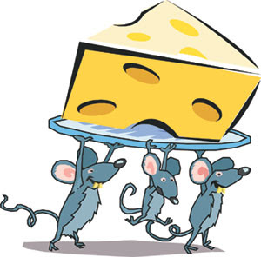
The Story of the Three Mice
First mouse – each time he pressed the button a tasty morsel of food was delivered.
Second mouse – faulty button delivered food inconsistently.
Third mouse – Button didn’t work at
Notes:
1st – secure – needs met both physically and emotionally – doesn’t have to be perfect – but predictable
2nd – constantly pressing the button – never know/sure what will happen – child that is constantly asking – may have answered/acknowledged many times
3rd – no response – therefore have to make their own way – hardest to shift (e.g.)steals in bins for food even though food needs now being met
What happens when put in house where the button now works?

Slide 3

What is attachment?
The dependency relationship a child develops towards his or her primary caregivers.
A deep, loving human relationship in early life is at the very core of self-esteem
Notes:
John Bowlby:
.. A bond which ties. It is the bond that ties the mother and baby together. It has developed in order to protect us from predators. It is central to our survival and well-being

Slide 4
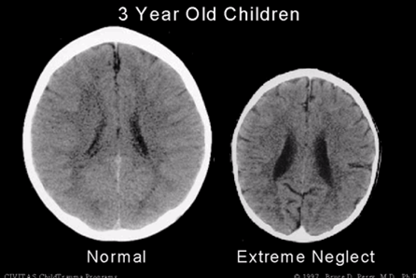
Neuroscience
Difficulties remaining calm
Difficulties learning and taking on information
Difficulties with emotional regulation
Notes:
John Bowlby:
.. A bond which ties. It is the bond that ties the mother and baby together. It has developed in order to protect us from predators. It is central to our survival and well-being

Slide 5
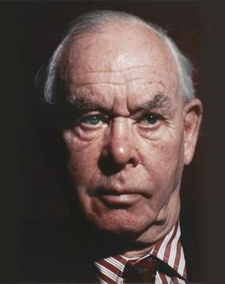
Attachment Theory – in a nutshell
John Bowlby (1988):
“lasting psychological connectedness between human beings”
Multiple attachments can occur with other adults throughout the lifespan, although early experiences may continue to have an impact.
Secure attachments support mental processes (mental representations the internal working model) that:
Regulate emotions
Reduce fear
Attune to others
Have self-understanding and insight
empathy for others
appropriate moral reasoning
Insecure attachments may mean child cannot rely on an adult to respond to their needs in times of stress, they are unable to:
Soothe themselves
Manage their emotions
Engage in reciprocal relationships
Notes:
Working with trauma: impact on staff – secondary stress.
Feelings that can result: hurt, angry, frustrated, intolerant, anxious, de-skilled. Projection of feelings onto staff.

Slide 6
Why Attachment Matters
These children can appear: - Unfocussed Disruptive - Controlling - Withdrawn - Destructive
Punished/excluded.
Difficulties forming relationships
Notes:
Working with trauma: impact on staff – secondary stress.
Feelings that can result: hurt, angry, frustrated, intolerant, anxious, de-skilled. Projection of feelings onto staff.

Slide 7
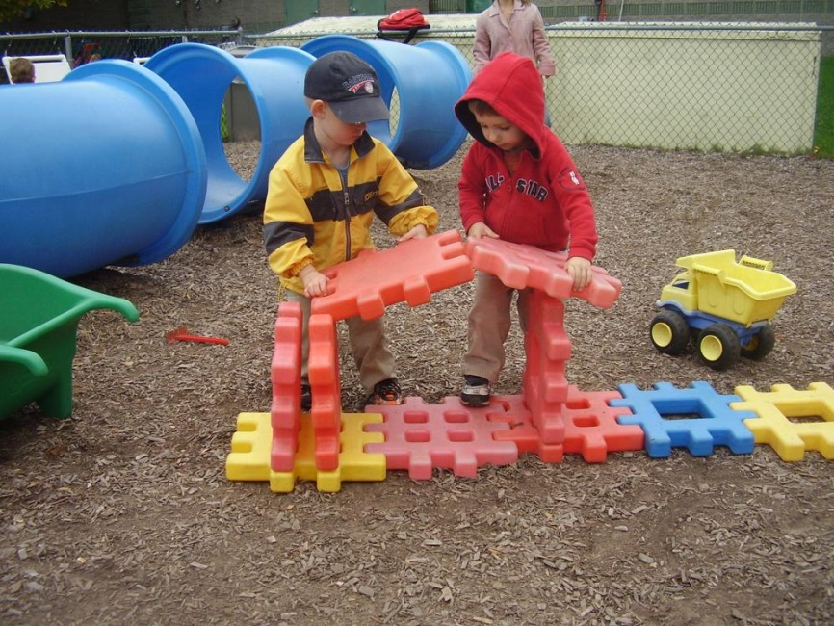
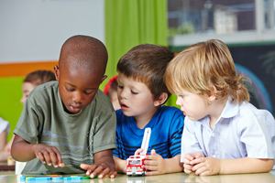
Securely attached children:
View the world as a safe place and view other people as a source of nurture & support
View themselves as worthy of attention and when they encounter difficulties, are more likely to seek help
Better problem solvers and more curious
Have increased quality and duration of learning
More socially empathetic and less biased in interpreting behaviour of others
Self – aware and more empathetic

Slide 8
Insecurely attached children – working with adults
Does not trust teacher/sees adults as a threat
Overly reliant on teacher attention
Notes:
Does not trust teacher/sees adult as a threat:
Very independent
Parent or adult is the ‘unsafe’ thing – violence, abuse, neglect, fear.
Constant survival mode, hyper-vigilant with a lack of trust for others
Perceive others as resources to be used
Difficulties forming close friendships, loving carers may be an overwhelming threat.
Reliant on teacher attention:
Led by separation anxiety. The attention of the teacher is the primary need and pre-occupation and the task can seem an intrusion and a threat.
Can seem anxious, clingy, but also feels angry towards the person s/he is dependent on.
Teacher can experience as relentless attention seeking- child often given additional support – which can sustain anxiety and reduce independence and autonomy – overly dependent on adults for help.
May try to take control, tell teacher what to do.

Slide 9
Does not trust teacher/sees adults as a threat | Overly reliant on teacher attention
Pair the child with a sympathetic peer -study buddies.
Use board games – structure, rules, predictability.
Over time the pupil experiences the sensitivity of the teacher to their anxiety – they begin to feel understood and more secure. Greater trust in the adult makes it more possible for them to ask for help.
Transition times, rituals very important in helping child manage emotions.
Task needs to be differentiated into small and achievable steps with repeated reminders that they are ‘held in mind’ by the teacher.

Slide 10
Insecurely attached children – approach to tasks
May overly focus on ‘what to do’ – not the task (self reliant)
Refusal
Notes:
Limited resilience/confidence
Independent:
Self-reliant (lack of exploration)
Transitions very difficult. Can lead to school phobia.
Internalizes difficulties (it was all my fault)
the humiliation of not knowing and fear of what they do not know
Refusal:
Inability to develop impulse controls or regulate stress (lying, stealing, violence, self-harm)
Unlikely to use language effectively
Excessive anxiety often linked to shame

Slide 11
May overly focus on ‘what to do’ – not the task (self reliant) | Refusal
The nature of the task is important – the pupil needs to feel sure it is ‘do-able’ without triggering the need for help.
Highly structured tasks prevent child being overwhelmed by feelings.
Have another child present so that the avoidant child can witness your relationship at a safe distance.
Engage the learner through the task not through the teacher – a shared focus on the task can protect the pupil from exposure to the relationship.
Need the experience of being ‘held’ in one place, being kept safe.

Slide 12
Why is knowing this important for you?
Teachers and other significant adults in a child’s life can provide important attachments for children
Quality of practitioner-child relationships and achievement
High quality practitioner-child relationships help buffer children from the negative effects of insecure attachment on achievement
Emotional resilience and the ability to learn are inextricably linked
Secure attachment relationships correlate strongly with higher academic attainment, better self-regulation and social competence
Notes:
Classrooms that support autonomy by encouraging pupil choice and cooperative learning, rather than behaviour controlling, are associated with higher self esteem
Children with low self esteem value structured, well controlled environments in which there is planned success, warmth and personal contact
Children need to experience success and to attribute that success to something they have carried out themselves
Praise needs to be specific and informative

Slide 13
So schools and teachers need to…
Create nurturing relationships to promote children’s learning and behaviour and satisfy children’s innate need to have a secure ‘sense of belonging’.
Acknowledge adults’ roles as a potential secondary attachment figure who can help to reshape insecure attachment behaviours and support the development of more secure ones.
Create additional infrastructures for children with emotional and behavioural impairments (as we do for physical and learning impairment).

Slide 14
Word of warning….
Social communicational/Autism Spectrum Disorder
Attention Deficit Hyperactivity Disorder (ADHD)
“Naughty” or “attention-seeking”
Notes:
- Coventry grid

Slide 15
Pause for Thought
What does a basic understanding of attachment tell you about your school’s approach to interpreting children’s behaviour?
Why might some existing behaviour management systems in schools not work for children with unmet attachment needs or trauma?
Think of a class of children that you work with. How might an understanding of attachment affect how this class is supported to learn more effectively?
Notes:
Working with trauma: impact on staff – secondary stress.
Feelings that can result: hurt, angry, frustrated, intolerant, anxious, de-skilled. Projection of feelings onto staff.

Slide 16
Summary
Nurturing attachments provide children with protective, safe havens and secure bases from which to explore and engage with others and their environment.
Attachment behaviours are very persistent and are often triggered when the child is in an anxious state (e.g. learning)
Insecurely attached children may be labelled as ‘attention seeking’, ‘disruptive’, ‘withdrawn’ etc.
Attachment theory believes that rewarding the child with attention is NOT reinforcing undesirable behaviour but actually promotes the attachment state. Once the attachment state has been achieved it facilitates more effective learning, improved sociability and better peer relationships
Adults in school can provide important attachments for children.

Slide 17
Thank you for listening

